Slide 1

Deep Learning
Notes:
‹#›

Slide 2
Objectives
What is deep learning?
How do neural networks work?
Applications of deep learning.

Slide 3
What is Deep Learning?
Subset of machine learning where the algorithms are structured based on the functionality of the brain.
Basic concept: in a brain, neurons fire when detecting certain features on an object.
This concept led to the development of artificial neural networks.
Neural networks are built to simulate how the brain interacts when provided with a stimulus to process data and learn from the new information.
Neural networks can utilize a single layer to make predictions and can utilize additional layers to optimize and improve the model’s performance.

Slide 4
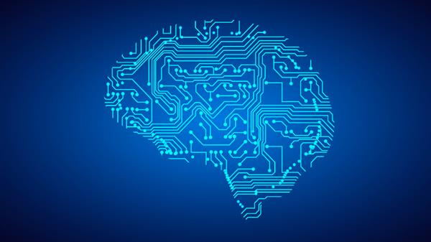
Visualize Deep Learning

Slide 5
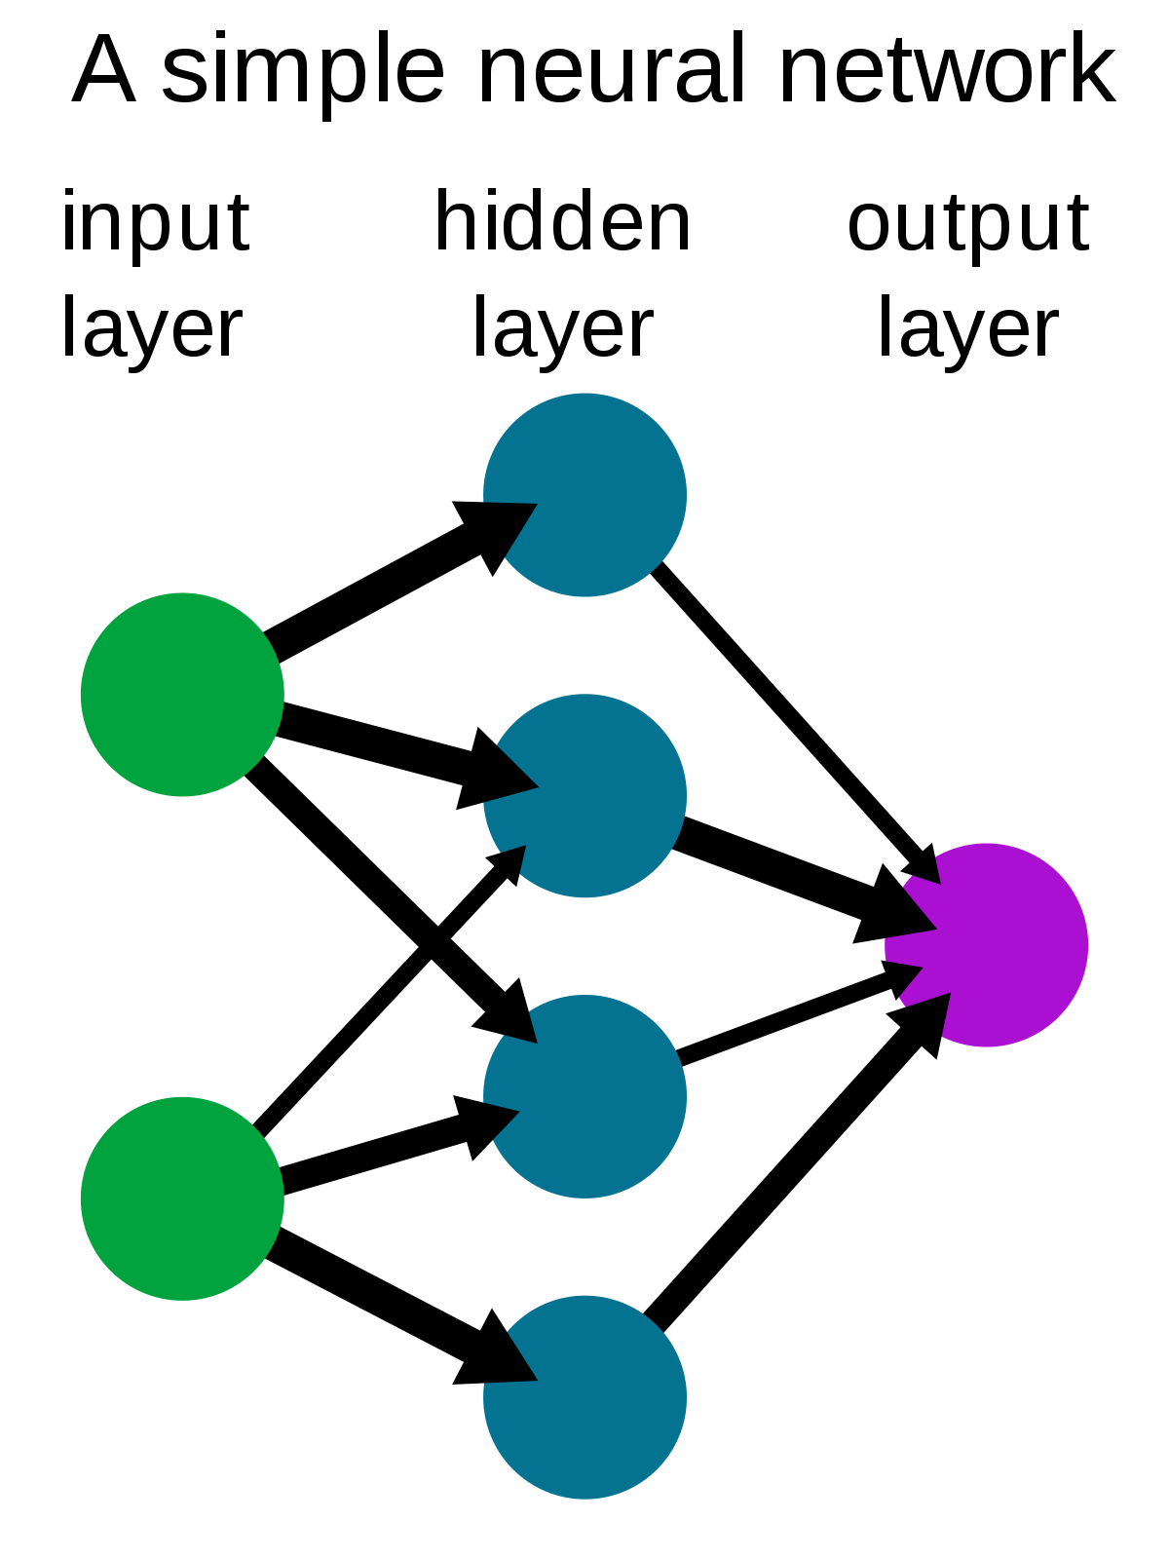
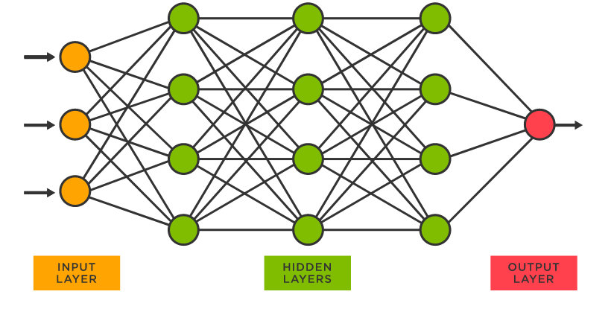
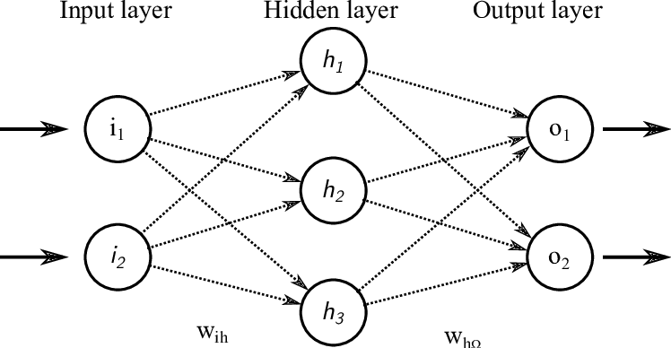
Simple Neural Network vs. Deep Neural Network

Slide 6
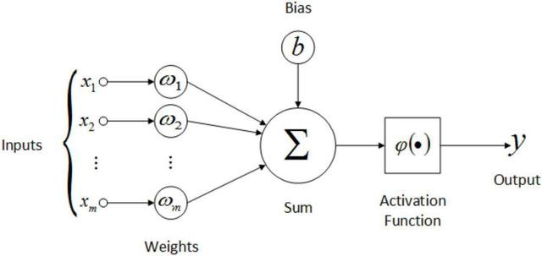
How Do Neural Networks Work?
In a neural network, layers are categorized in the following: input layer, hidden layer, output layer.
Neural networks utilize activation units to perform a weighted sum of the inputs for processing data.
Each layer in the network can have a different number of activation units.
The activation function and units control how well the model learns the training dataset.

Slide 7
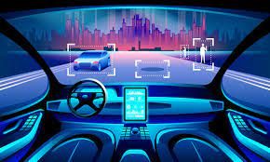

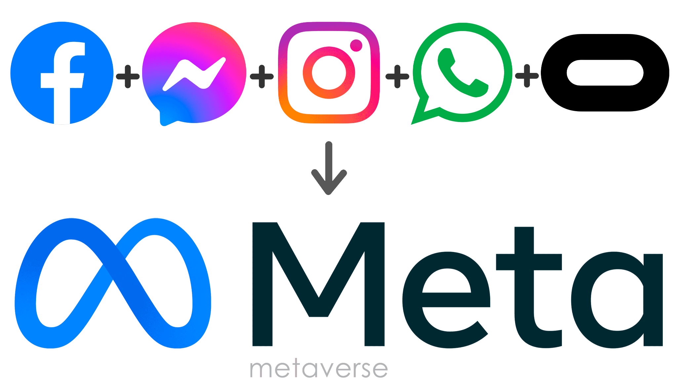
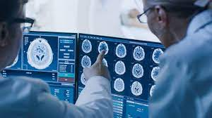
Applications of Deep Learning
Virtual assistants.
Social media.
Autonomous vehicles.
Healthcare.

